Slide 1
GKE Setup Instructions
By K.C.Ashish Kumar

Slide 2
Install via Jenkins Job
http://authub-jenkins-srv.lvn.broadcom.net:8080/
IAM-PUBLIC >> deploy-ngnx-enclave-ssp-on-gke-bm-cluster-kickoff-harness
Build with Parameters (Refer Screenshot)
The build normally takes 20-30 Minutes
Note: For the first time deployment also select the below 2 options: setup_ingress deploy_enclave

Slide 3
Common COMMANDS:
Install gcloud SDK - https://cloud.google.com/sdk/docs/
Also install the “kubectl” component
gcloud auth login
gcloud config set project <PROJECT_ID>
gcloud container clusters get-credentials <clusterName> --region us-central1-c --project <PROJECT_ID> command for connecting to the cluster
kubectl get nodes -o wide command for getting the information about internal/external IP
kubectl get pods,svc -n idstore command for getting information about ports for LDAP (here the namespace is “idstore”)
kubectl get pods -n <namespace> command for getting all the pods in a specific namespace (Also can use pod argument instead of pods)
kubectl describe pods -n ssp1 command to get detailed information for pods in a specific namespace (Also can use pod argument instead of pods)
kubectl describe pods <podName> -n <namespace> command to describe a specific pod within a specific namespace (Also can use pod argument instead of pods)
kubectl --help General help
kubectl get --help Help for the get argument
helm ls -A (For checking the various deployments)
kubectl get ingress -A (For checking the various ingress hostnames)
systemctl enable haproxy (For enabling haproxy)
journalctl –u haproxy (For checking haproxy logs)
reboot –reboot (For rebooting the machine)

Slide 4
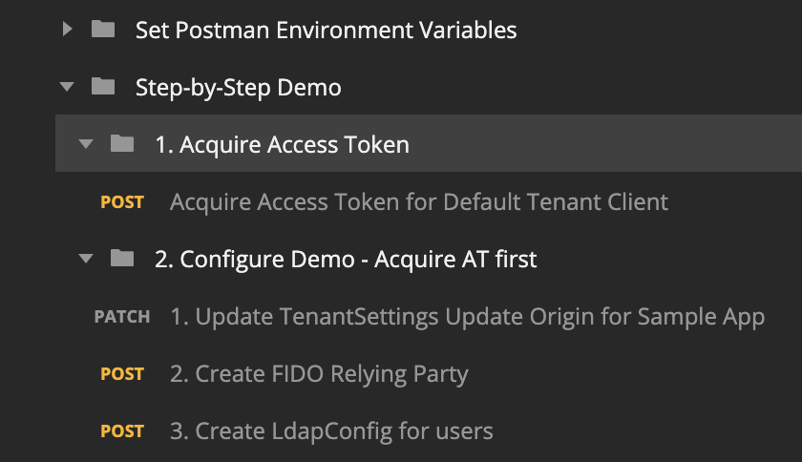
Configure LDAP & Users
Go to POSTMAN and execute the “Step by Step Demo >> Configure Demo” i.e. execute the steps in screenshot. This will create the LDAP Config for the GKE Environment. Note: It is mandatory to execute all the shown steps i.e. 1.1, 2.1, 2.2, 2.3

Slide 5
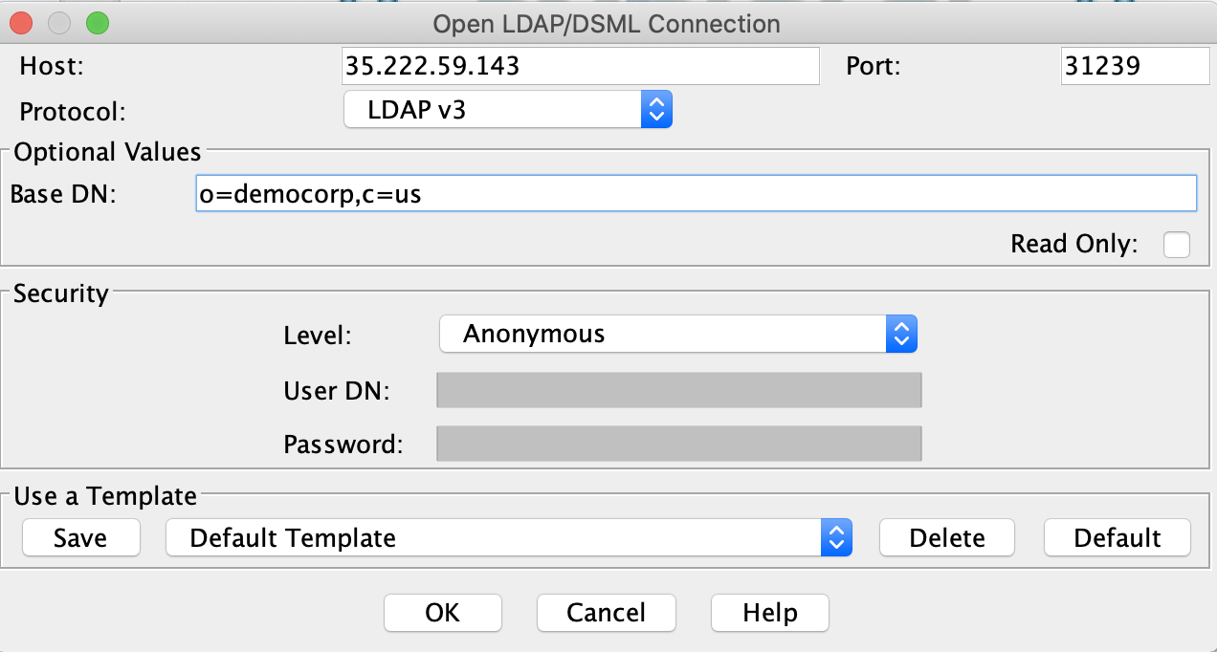
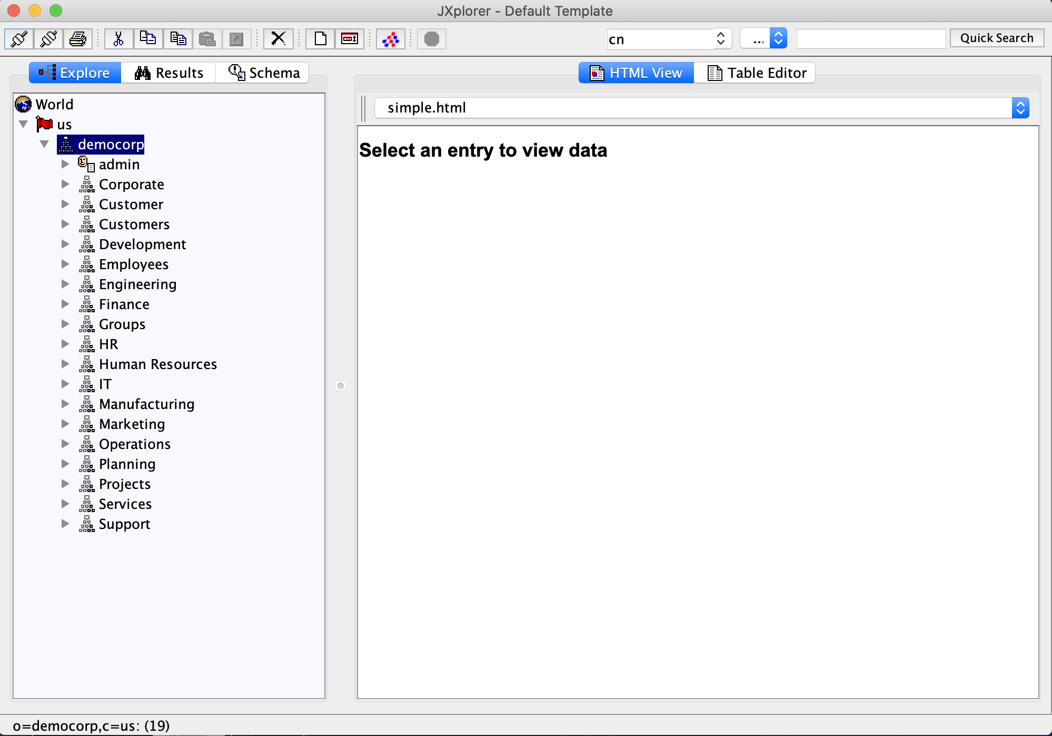
Configure LDAP & Users
Install Java & JXplorer, Run JXplorer
Use the external IP & the port obtained from the kubectl command ExternalIP: kubectl get nodes -o wide LDAP Port: kubectl get pods,svc -n idstore
Refer the 1st screenshot for Base DN
Save the settings as a template e.g. Default Template
Connect (Press OK) (Refer 2nd screenshot for screen after successful connection) Contd . . .

Slide 6
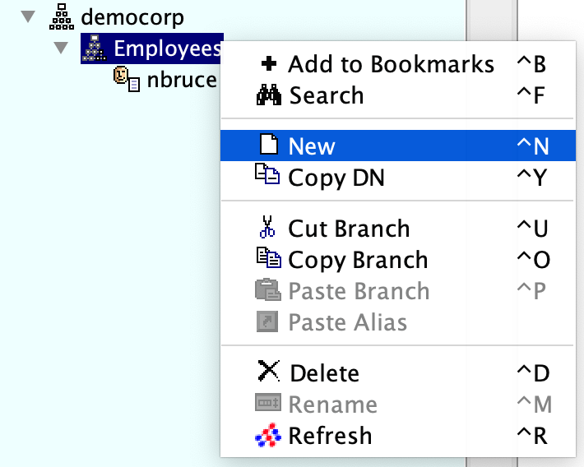
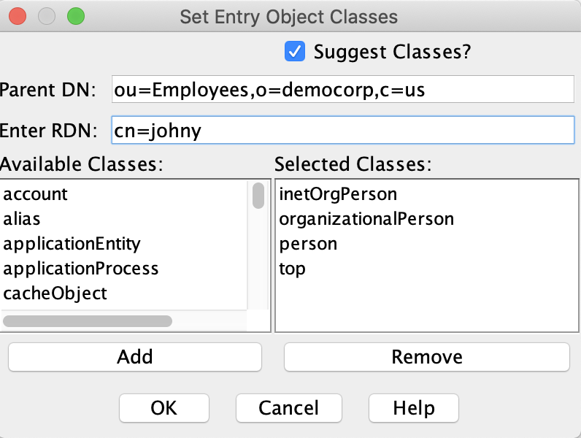
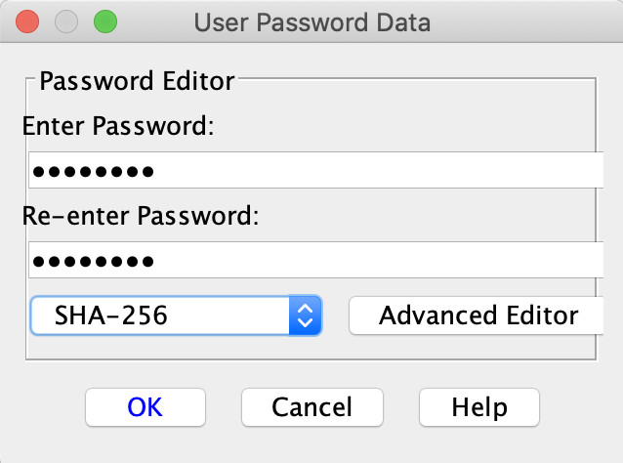
Configure LDAP & Users
In the search bar, search for an existing user e.g. nbruce
In the results, right-click on Employees & select ‘New’
Refer the 2nd screenshot for values, replace ‘johny’ with the desired username. Click OK
In the next screen, fill out the mandatory values like ‘sn’ (Surname), userPassword.
For userPassword, select type as SHA-256
Click “Submit”
Go to HTML View and fill out other fields if needed like phone, email & click Submit
Sometimes the password isn’t set properly, so use the HTML View to set the password again and hit Submit. Contd . . .

Slide 7
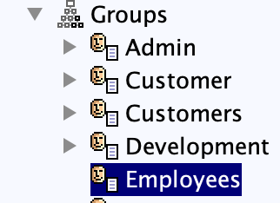

Configure LDAP & Users
Go to the “Explore” tab and select “Groups >> Employees” (Refer: screenshot)
In the right “Table Editor” view, add a new “member” entry for the new user “johny” like the existing entries. (Refer: 2nd screenshot)
Click Submit
The new user account “johny” is now ready.

Slide 8
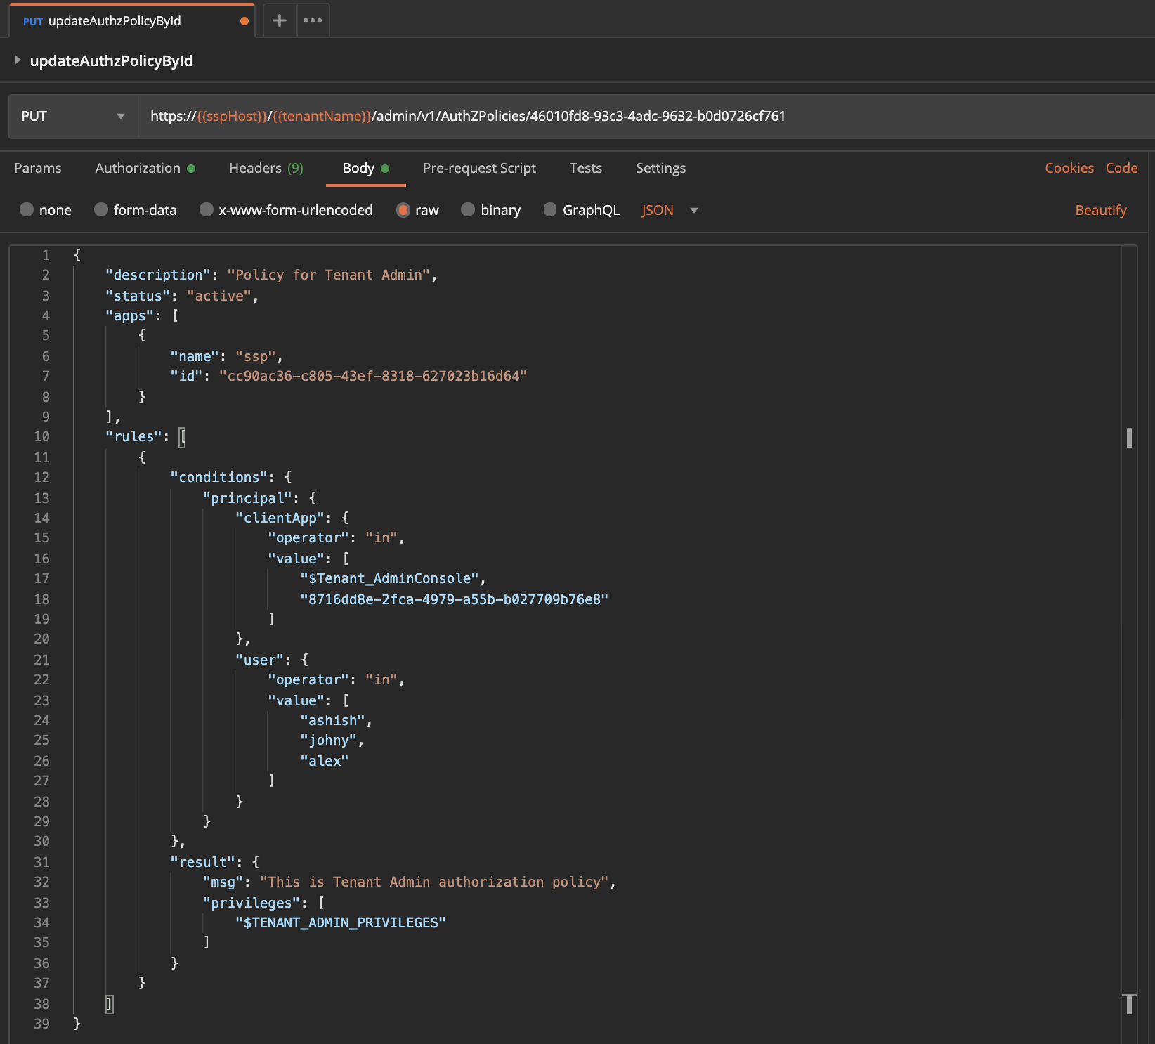
Adding Users to Authz Policy
Refer the example screenshot to add “user” inside the “principal” line# 21 – 28 POSTMAN Script: updateAuthzPolicyById

Slide 9
Setup Index-Patterns in Kibana
Open the “kibana” url in the browser.
Click on “Discover” or the “D” in top bar and click “Manage Spaces”
Select option “Index Patterns” and then select the appropriate index i.e. ssp_log* (or) ssp_audit* and click Next
Create a filter with @timestamp and save.

